Slide 1

Logic Programming
Chapter 4
Companion slides from the book

Slide 2
Objectives
Understand the nature of logic programming
Understand Horn clauses
Understand resolution and unification
Become familiar with the Prolog language
Explore the problems with logic programming

Slide 3
Introduction
Logic: the science of reasoning and proof
Existed since the time of ancient Greek philosophers
Logic is closely associated with computers and programming languages
Circuits are designed using Boolean algebra
Logical statements are used to describe axiomatic semantics, the semantics of programming languages

Slide 4
Introduction (cont’d.)
Logical statements can be used as formal specifications
Computers are used to implement the principles of mathematical logic
Automatic deduction systems or automatic theorem provers turn proofs into computation
Computation can be viewed as a kind of proof
Led to the programming language Prolog

Slide 5
Logic and Logic Programs
First-order predicate calculus: a way of formally expressing logical statements
Logical statements: statements that are either true or false
Axioms: logical statements that are assumed to be true and from which other true statements can be proved

Slide 6
Logic and Logic Programs (cont’d.)
First-order predicate calculus statement parts:
Constants: usually numbers or names
Predicates: names for functions that are true or false
Functions: functions that return non-Boolean values
Variables that stand for as yet unspecified quantities
Connectives: operations such as and, or, not, implication (→) equivalence (←→)
Quantifiers: operations that introduce variables
Punctuation symbols: parentheses, comma, period

Slide 7
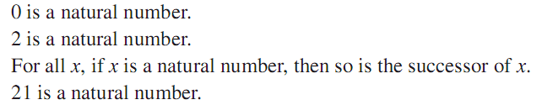
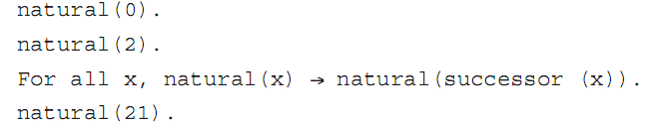
Logic and Logic Programs (cont’d.)
Example 1:
These English statements are logical statements:
Translation into predicate calculus:

Slide 8
Logic and Logic Programs (cont’d.)
Example 1 (cont’d.):
First and third statements are axioms
Second statement can be proved since:
x in the third statement is a variable that stands for an as yet unspecified quantity

Slide 9
Logic and Logic Programs (cont’d.)
Universal quantifier: a relationship among predicates is true for all things in the universe named by the variable
Ex: for all x
Existential quantifier: a predicate is true for at least one thing in the universe indicated by the variable
Ex: there exists x
A variable introduced by a quantifier is said to be bound by the quantifier

Slide 10
Logic and Logic Programs (cont’d.)
A variable not bound by a quantifier is said to be free
Arguments to predicates and functions can only be terms: combinations of variables, constants, and functions
Terms cannot contain predicates, quantifiers, or connectives

Slide 11
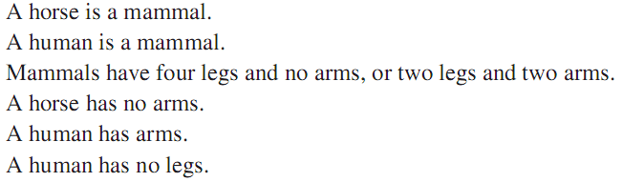
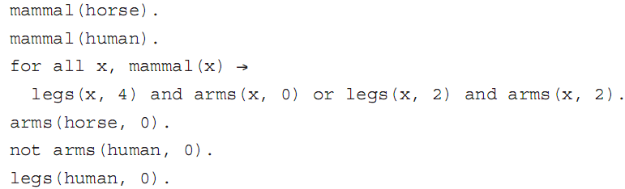
Logic and Logic Programs (cont’d.)
Example 2:

Slide 12

Logic and Logic Programs (cont’d.)
First-order predicate calculus also has inference rules
Inference rules: ways of deriving or proving new statements from a given set of statements
Example: from the statements a→b and b→c, one can derive the statement a→c, written formally as:

Slide 13
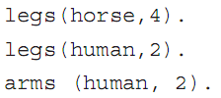
Logic and Logic Programs (cont’d.)
From Example 2, we can derive these statements:
Theorems: statements derived from axioms
Logic programming: a collection of statements is assumed to be axioms, and from them a desired fact is derived by the application of inference rules in some automated way

Slide 14
Logic and Logic Programs (cont’d.)
Logic programming language: a notational system for writing logical statements together with specified algorithms for implementing inference rules
Logic program: the set of logical statements that are taken to be axioms
The statement(s) to be derived can be viewed as the input that initiates the computation
Also called queries or goals
there exists y, legs(Human, 2) ?
yes: …

Slide 15
Logic and Logic Programs (cont’d.)
Logic programming systems are sometimes referred to as deductive databases
Consist of a set of statements and a deduction system that can respond to queries
System can answer queries about facts and queries involving implications
Control problem: specific path or sequence of steps used to derive a statement

Slide 16
Logic and Logic Programs (cont’d.)
Logical programming paradigm (Kowalski):
algorithm = logic + control
Compare this with imperative programming (Wirth):
algorithms = data structures + programs
Since logic programs do not express the control, in theory, operations can be carried out in any order or simultaneously
Logic programming languages are natural candidates for parallelism

Slide 17
Logic and Logic Programs (cont’d.)
Automated deduction systems have difficulty handling all of first-order predicate calculus
Too many ways of expressing the same statements
Too many inference rules
Most logic programming systems restrict themselves to a particular subset of predicate calculus called Horn clauses

Slide 18

Horn Clauses
Horn clause: a statement of the form
The a_{i} are only allowed to be simple statements
No or connectives and no quantifiers allowed
This statement says that a₁ through a_{n} imply b, or that b is true if all the a_{i} are true
b is the head of the clause
The a₁,…,a_{n} is the body of the clause
If there are no a_{i}’s, the clause becomes → b
b is always true and is called a fact

Slide 19

Horn Clauses (cont’d.)
Example 4: first-order predicate calculus:
Translate these into Horn clauses by dropping the quantifier:

Slide 20


Horn Clauses (cont’d.)
Example 5: logical description for the Euclidian algorithm for greatest common divisor of two positive integers u and v:
First-order predicate calculus:

Slide 21
Horn Clauses (cont’d.)
Note that gcd(u,v,w) is a predicate expressing that w is the gcd of u and v
Translate into Horn clauses by dropping the quantifiers:

Slide 22

Horn Clauses (cont’d.)
Example 6: logical statements
Predicate calculus:
Horn clause:

Slide 23

Horn Clauses (cont’d.)
Example 7: logical statements:
Predicate calculus:
This may be approximated by these Horn clauses:
In general, the more connectives that appear on the right of a → connective, the harder it is to translate into a set of Horn clauses

Slide 24

Horn Clauses (cont’d.)
Procedural interpretation: Horn clauses can be reversed to view them as a procedure
This becomes procedure b, wherein the body is the operations indicated by the a_{i}’s
Similar to how context-free grammar rules are interpreted as procedure definitions in recursive descent parsing
Logic programs can be used to directly construct parsers

Slide 25
Horn Clauses (cont’d.)
Parsing of natural language was a motivation for the original development of Prolog
Definite clause grammars: the particular kind of grammar rules used in Prolog programs
Horn clauses can also be viewed as specifications of procedures rather than strictly as implementations
Example: specification of a sort procedure:

Slide 26

Horn Clauses (cont’d.)
Horn clauses do not supply the algorithms, only the properties that the result must have
Most logic programming systems write Horn clauses backward and drop the and connectives:
Similar to standard programming language expression for the gcd:

Slide 27

Horn Clauses (cont’d.)
Variable scope:
Variables used in the head can be viewed as parameters
Variables used only in the body can be viewed as local, temporary variables
Queries or goal statements: the exact opposite of a fact
Are Horn clauses with no head
Examples:

Slide 28

Resolution and Unification
Resolution: an inference rule for Horn clauses
If the head of the first Horn clause matches with one of the statements in the body of the second Horn clause, can replace the head with the body of the first in the body of the second
Example: given two Horn clauses
If b_{i} matches a, then we can infer this clause:

Slide 29
Resolution and Unification (cont’d.)
Example: given b←a and c←b
Resolution says c←a
Example: given b←a and c←b
Combine: b,c,←a,b
Cancel the b on both sides: c←a

Slide 30
Resolution and Unification (cont’d.)
A logic processing system uses this process to match a goal and replace it with the body, creating a new list of goals, called subgoals
If all goals are eventually eliminated, deriving the empty Horn clause, then the original statement has been proved
To match statements with variables, set the variables equal to terms to make the statements identical and then cancel from both sides
This process is called unification
Variables used this way are said to be instantiated

Slide 31
Resolution and Unification (cont’d.)
Example 10: gcd with resolution and unification
Goal:
Resolution fails with first clause (10 does not match 0), so use the second clause and unify:

Slide 32
Resolution and Unification (cont’d.)
Example 10 (cont’d.):
If zero(10) is false, then not zero(10) is true
Simplify 15 mod 10 to 5, and cancel gcd (15, 10, x) from both sides, giving:
Use unification as before:
To get this subgoal:
This now matches the first rule, so setting x to 5 gives the empty statement

Slide 33
Resolution and Unification (cont’d.)
A logic programming system must have a fixed algorithm that specifies:
Order in which to attempt to resolve a list of goals
Order in which clauses are used to resolve goals
In some cases, order can have a significant effect on the answers found
Logic programming systems using Horn clauses and resolution with prespecified orders require that the programmer is aware of the way the system produces answers

Slide 34
The Language Prolog
Prolog: the most widely used logic programming language
Uses Horn clauses
Implements resolution via a strictly depth-first strategy
There is now an ISO standard for Prolog
Based on the Edinburgh Prolog version developed in the late 1970s and early 1980s

Slide 35
Notation and Data Structures
Prolog notation is almost identical to Horn clauses
Implication arrow ← becomes :-
Variables are uppercase, while constants and names are lowercase
In most implementations, can also denote a variable with a leading underscore
Use comma for and, semicolon for or
List is written with square brackets, with items separated by commas
Lists may contain terms or variables

Slide 36
Notation and Data Structures (cont’d.)
Can specify head and tail of list using a vertical bar
Example: [H|T] = [1, 2, 3] means H = 1, T = [2, 3]
Example: [X, Y|Z] = [1, 2, 3] means X=1, Y=2, and Z=[3]
Built-in predicates include not, =, and I/O operations read, write, and nl (newline)
Less than or equal is usually written =< to avoid confusion with implication

Slide 37
Execution in Prolog
Most Prolog systems are interpreters
Prolog program consists of:
Set of Horn clauses in Prolog syntax, usually entered from a file and stored in a dynamically maintained database of clauses
Set of goals, entered from a file or keyboard
At runtime, the Prolog system will prompt for a query

Slide 38

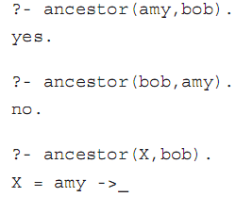
Execution in Prolog (cont’d.)
Example 11: clauses entered into database
Queries:

Slide 39
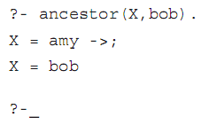
Execution in Prolog (cont’d.)
Example 11 (cont’d.): use semicolon at prompt (meaning or)
Use carriage return to cancel the continued search

Slide 40


Arithmetic
Prolog has built-in arithmetic operations
Terms can be written in infix or prefix notation
Prolog cannot tell when a term is arithmetic or strictly data
Must use built-in predicate is to force evaluation

Slide 41

Arithmetic (cont’d.)
Greatest common divisor algorithm
In generic Horn clauses:
In Prolog:

Slide 42
Unification
Unification: process by which variables are instantiated to match during resolution
Basic expression whose semantics is determined by unification is equality
Prolog’s unification algorithm:
Constant unifies only with itself
Uninstantiated variable unifies with anything and becomes instantiated to that thing
Structured term (function applied to arguments) unifies with another term only if the same function name and same number of arguments

Slide 43
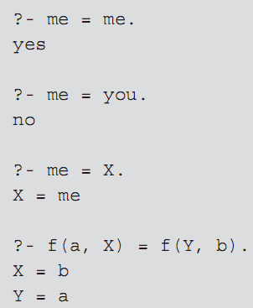
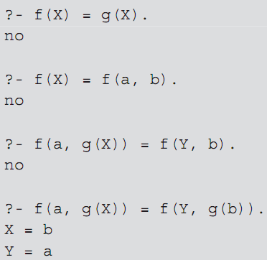
Unification (cont’d.)
Examples:

Slide 44

Unification (cont’d.)
Unification causes uninstantiated variables to share memory (to become aliases of each other)
Example: two uninstantiated variables are unified
Pattern-directed invocation: using a pattern in place of a variable unifies it with a variable used in that place in a goal
Example:

Slide 45
Unification (cont’d.)
Append procedure:
First clause: appending a list to the empty list gives just that list
Second clause: appending a list whose head is A and tail is B to a list Y gives a list whose head is also A and whose tail is B with Y appended

Slide 46




Unification (cont’d.)
Append procedure rewritten more concisely:
Append can also be run backward and find all the ways to append two lists to get a specified list:

Slide 47

Unification (cont’d.)
Reverse procedure:

Slide 48
Reverse Clause
Reversing a list can be done with
reverse([X|Y],Z,W) :- reverse(Y,[X|Z],W). reverse([],X,X).
?- reverse([1,2,3],[],A)

Slide 49
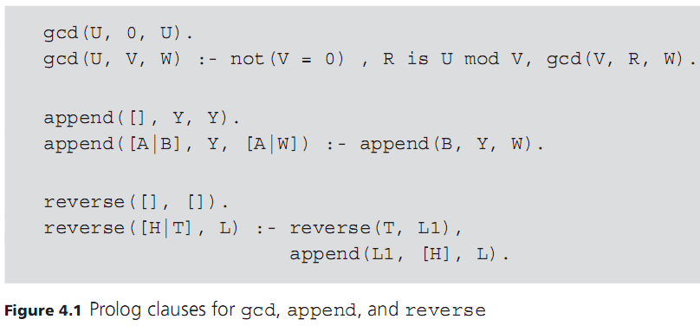
Unification (cont’d.)

Slide 50
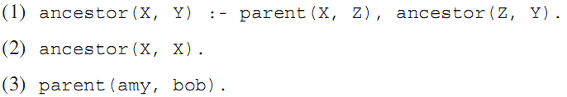
Prolog’s Search Strategy
Prolog applies resolution in a strictly linear fashion
Replaces goals from left to right
Considers clauses in the database from top down
Subgoals are considered immediately
This search strategy results in a depth-first search on a tree of possible choices
Example:

Slide 51
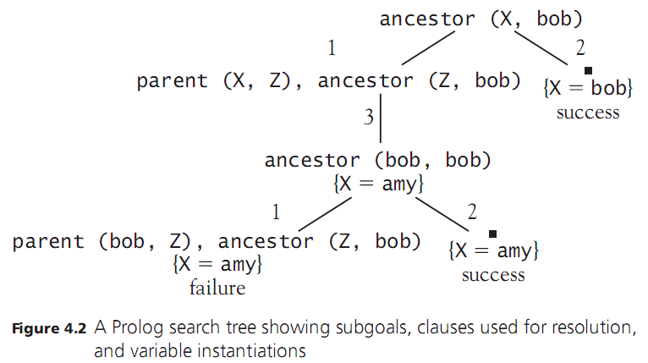
Prolog’s Search Strategy (cont’d.)

Slide 52
Prolog’s Search Strategy (cont’d.)
Leaf nodes in the tree occur either when no match is found for the leftmost clause or when all clauses have been eliminated (success)
If failure, or the user indicates a continued search with a semicolon, Prolog backtracks up the tree to find further paths
Depth-first strategy is efficient: can be implemented in a stack-based or recursive fashion
Can be problematic if the search tree has branches of infinite depth

Slide 53
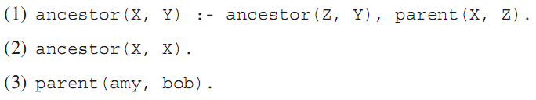
Prolog’s Search Strategy (cont’d.)
Example: same clauses in different order
Causes Prolog to go into an infinite loop attempting to satisfy ancestor (Z, Y), continually reusing the first clause
Breadth-first search would always find solutions if they exist
Far more expensive than depth-first, so not used

Slide 54
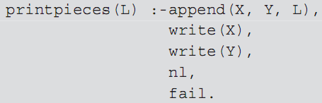
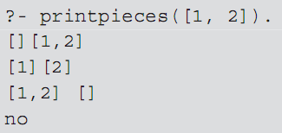
Loops and Control Structures
Can use the backtracking of Prolog to perform loops and repetitive searches
Must force backtracking even when a solution is found by using the built-in predicate fail
Example:

Slide 55

Loops and Control Structures (cont’d.)
Use this technique also to get repetitive computations
Example: these clauses generate all integers greater than or equal to 0 as solutions to the goal num(X)
The search tree has an infinite branch to the right

Slide 56
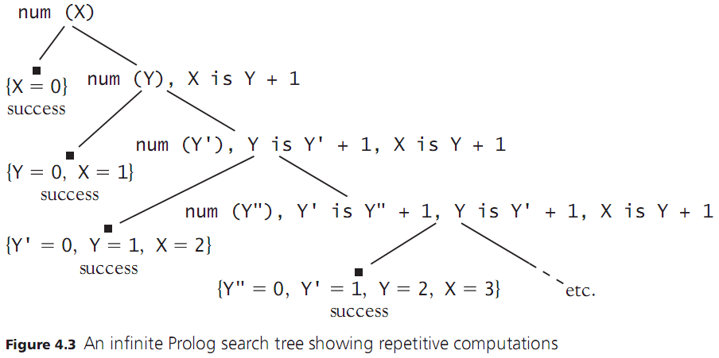
Loops and Control Structures (cont’d.)

Slide 57
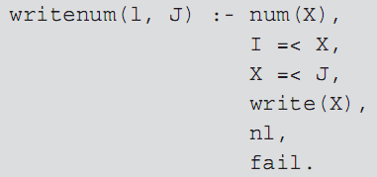
Loops and Control Structures (cont’d.)
Example: trying to generate integers from 1 to 10
Causes an infinite loop after X = 10, even though X =< 10 will never succeed
cut operator (written as !) freezes a choice when it is encountered

Slide 58
?- max(2,3,3)
?- max(3,2,3)
?- max(3,3,3)
?- max(2,3,2)
?- max(2,3,5)
?- max(2,3,X)
max(X,Y,Y):- X =< Y. The two clauses are mutually exclusive! max(X,Y,X):- X>Y.
max(X,Y,Y):- X =< Y,!. max(X,Y,X):- X>Y.
Green Cuts:- Cuts like this, which doesn’t change the meaning of a program

Slide 59

Loops and Control Structures (cont’d.)
If a cut is reached on backtracking, search of the subtrees of the parent node stops, and the search continues with the grandparent node
Cut prunes the search tree of all other siblings to the right of the node containing the cut
Example:
Only X = amy will be found since the branch containing X = bob will be pruned

Slide 60
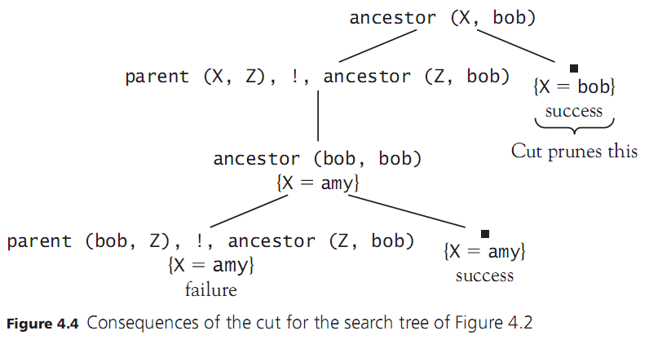
Loops and Control Structures (cont’d.)

Slide 61

Loops and Control Structures (cont’d.)
Rewriting this example:
No solutions will be found

Slide 62
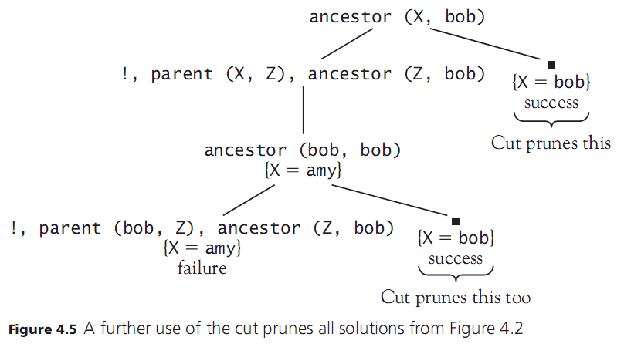
Loops and Control Structures (cont’d.)

Slide 63

Loops and Control Structures (cont’d.)
Rewriting again:
Both solutions will still be found since the right subtree of ancestor(X, bob) is not pruned
Cut can be used to reduce the number of branches in the subtree that need to be followed
Also solves the problem of the infinite loop in the program to print numbers between I and J shown earlier

Slide 64
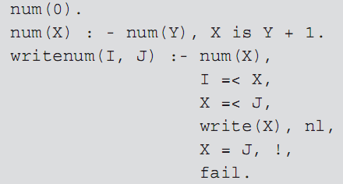
Loops and Control Structures (cont’d.)
One solution to infinite loop shown earlier:
X = J will succeed when the upper-bound J is reached
The cut will cause backtracking to fail, halting the search for new values of X

Slide 65


Loops and Control Structures (cont’d.)
Can also use cut to imitate if-else constructs in imperative and functional languages, such as:
D = if A then B else C
Prolog code:
Could achieve almost same result without the cut, but A would be executed twice

Slide 66
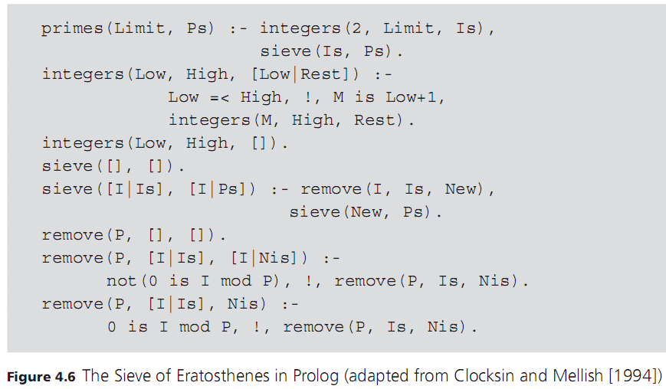
Loops and Control Structures (cont’d.)

Slide 67
Problems with Logic Programming
Original goal of logic programming was to make programming a specification activity
Allow the programmer to specify only the properties of a solution and let the language implementation provide the actual method for computing the solution
Declarative programming: program describes what a solution to a given problem is, not how the problem is solved
Logic programming languages, especially Prolog, have only partially met this goal

Slide 68
Problems with Logic Programming (cont’d.)
The programmer must be aware of the pitfalls in the nature of the algorithms used by logic programming systems
The programmer must sometimes take an even lower-level perspective of a program, such as exploiting the underlying backtrack mechanism to implement a cut/fail loop

Slide 69
The Occur-Check Problem in Unification
Occur-check problem: when unifying a variable with a term, Prolog does not check whether the variable itself occurs in the term it is being instantiated to
Example:
This will be true if there exists an X for which X is its own successor
But even in the absence of any other clauses for successor, Prolog answers yes

Slide 70
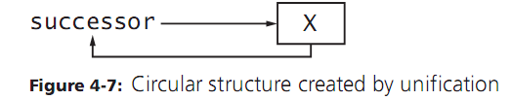
The Occur-Check Problem in Unification (cont’d.)
This becomes apparent if we make Prolog try to print such an X:
Prolog responds with an infinite loop because unification has constructed X as a circular structure
What should be logically false now becomes a programming error

Slide 71

Negation as Failure
Closed-world assumption: something that cannot be proved to be true is assumed to be false
Is a basic property of all logic programming systems
Negation as failure: the goal not(X) succeeds whenever the goal X fails
Example: program with one clause:
If we ask:
The answer is yes since the system has no knowledge of mother
If we add facts about mother, this would no longer be true

Slide 72
Negation as Failure (cont’d.)
Nonmonotonic reasoning: the property that adding information to a system can reduce the number of things that can be proved
This is a consequence of the closed-world assumption
A related problem is that failure causes instantiation of variables to be released by backtracking
A variable may no longer have an appropriate value after failure

Slide 73
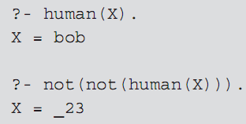
Negation as Failure (cont’d.)
Example: assumes the fact human(bob)
The goal not(not(human(X))) succeeds because not(human(X)) fails, but the instantiation of X to bob is released

Slide 74
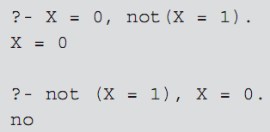
Negation as Failure (cont’d.)
Example:
The second pair of goals fails because X is instantiated to 1 to make X = 1 succeed, and then not(X=1) fails
The goal X = 0 is never reached

Slide 75

Horn Clauses Do Not Express All of Logic
Not every logical statement can be turned into Horn clauses
Statements with quantifiers may be problematic
Example:
Attempting to use Prolog, we might write:
Causes an error: trying to redefine the not operator

Slide 76
Horn Clauses Do Not Express All of Logic (cont’d.)
A better approximation would be simply p(a)
Closed-world assumption will force not(p(X)) to be true for all X not equal to a
But this is really the logical equivalent of:
This is not the same as the original statement

Slide 77
Control Information in Logic Programming
Because of its depth-first search strategy and linear processing of goals and statements, Prolog programs also contain implicit information on control that can cause programs to fail
Changing the order of the right-hand side of a clause may cause an infinite loop
Changing the order of clauses may find all solutions but still go into an infinite loop searching for further (nonexistent) solutions

Slide 78
Control Information in Logic Programming
One would want a logic programming system to accept a mathematical definition and find an efficient algorithm to compute it
Instead, we must specify actual steps in the algorithm to get a reasonable efficient sort

Slide 79
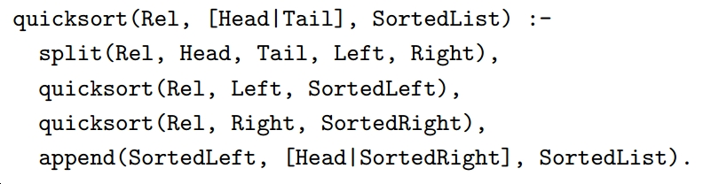
Quick sort
For the recursive rule, we first remove the Head from the unsorted list and split the Tail into those elements preceding Head wrt. the ordering Rel (list Left) and the remaining elements (list Right). Then Left and Right are being sorted, and finally everything is put together to return the full sorted list

Slide 80
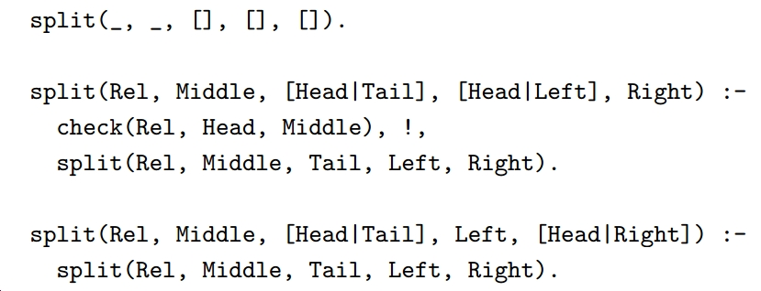
Quick Sort

